Slide 1
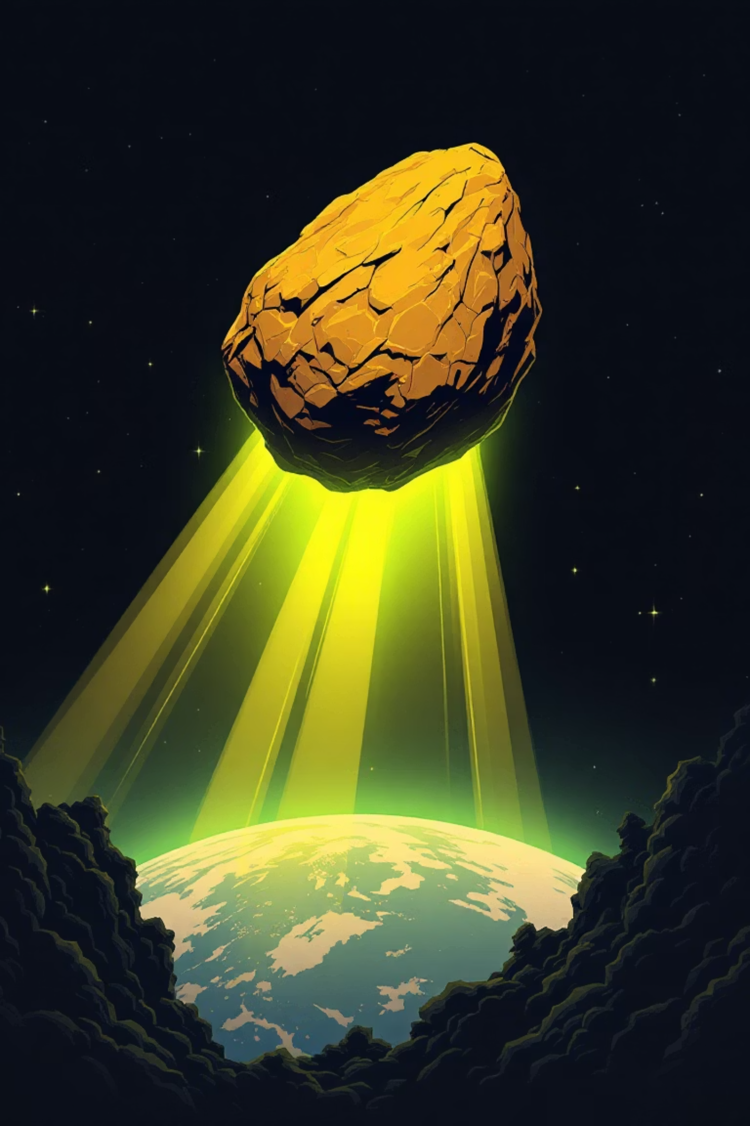



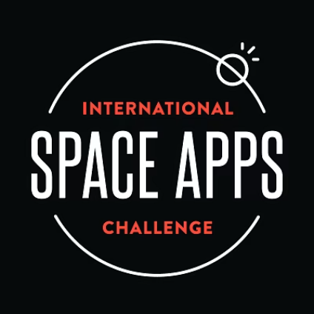



METEOR
MADNESS
Predict. Visualize. Defend.
A Project by: YMB Developing
1
YIGITHAN KARABEL - SOFTWARE ENGINEER
MUHAMMED TUNC - SOFTWARE ENGINEER
BERKE KILIC - SOFTWARE ENGINEER
MUHAMMED EMIN AYDIN - SOFTWARE ENGINEER
BURAK DURSUN – PROJECT LEAD / SOFTWARE ENGINEER
NASA International Space Apps Challenge 2025

Slide 2

The Unthinkable Threat: Impactor-2025
A new threat looms — “Impactor-2025,” a near-Earth asteroid racing toward our planet. Humanity needs more than just tracking data; it needs strategic preparation.
Our mission: to transform raw NASA data into a powerful interactive simulator that lets anyone predict, visualize, and defend Earth.
From impact energy to blast radius, our tool brings science and strategy together — helping humanity prepare before the next rock hits home.

Slide 3




CHAPTER 1: THE PROBLEM
Bridging the Data-Action Gap
NASA and other agencies track over 30,000 Near-Earth Objects, yet only a fraction of the public understands their real-world impact potential. However, this critical information often remains inaccessible or difficult to interpret for public and emergency planners.
Data Obscurity
The public cannot easily see what the raw astronomical data truly means for their region.
Strategy Deficit
We lack accessible, science-driven visual tools to communicate real-world impact consequences.
Our simulator is designed to translate the complex physics of planetary impact into clear, geographical, and demographic insights.

Slide 4









CHAPTER 2: OUR SOLUTION
The Interactive Defense Platform
We developed a powerful interactive web platform that merges dynamic astrophysics simulation with geographic reality mapping.
This platform transforms complex orbital data into tangible insights for scientists, educators, and decision-makers worldwide.
End-to-End Workflow
Custom Simulation
Users input asteroid size, speed, and angle to customize the impact scenario.
Data Ingestion
Direct feed from NASA NEO API and rich USGS topographical datasets.
Instant Visualization
Immediate calculation and display of crater size, shockwave, and regional damage maps.
Results are generated in under 2 seconds per simulation.
Core Technology Stack
Backend Engine
Frontend & UI
Data Layers
FastAPI + Python handle the heavy lifting of physics-based impact simulation.
React + Three.js + Tailwind CSS provides a fast, modern interface with high-fidelity 3D rendering.
Integrating NASA NEO API to simulate asteroid impacts.

Slide 5
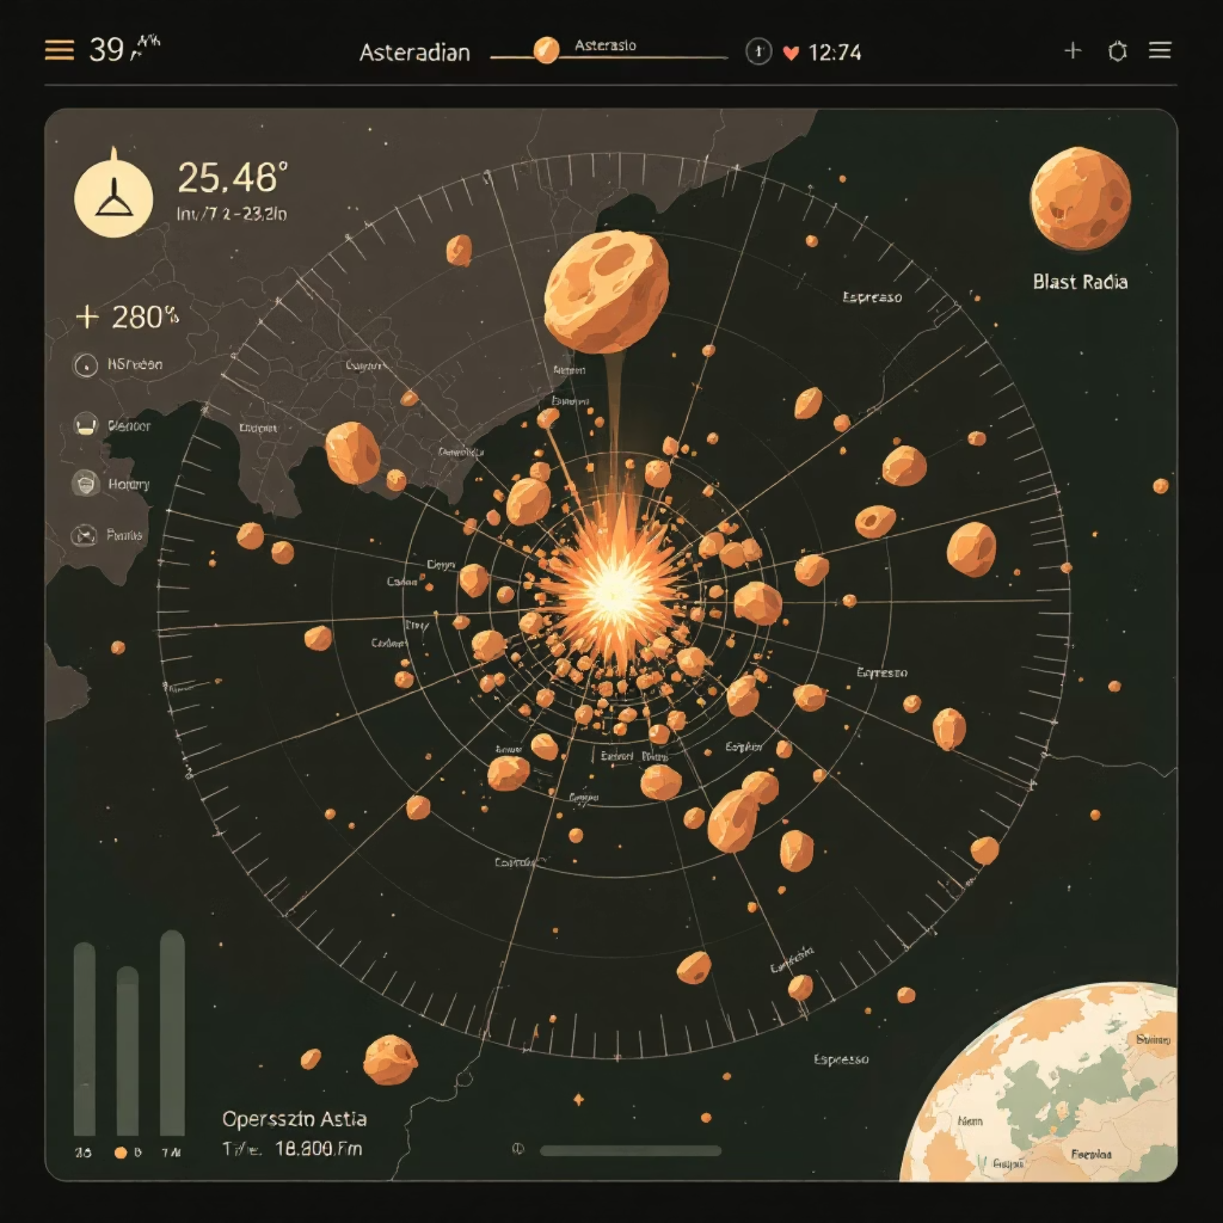




CHAPTER 3: IMPACT & RESULTS
Key Features: Modeling the Catastrophe
Each module transforms space data into insights that can guide emergency response, inform public awareness, and inspire next-generation defenders.
Our platform delivers specific, actionable intelligence that transcends abstract physics equations.
Dynamic 3D Impact Visualizations
Witness the event from any angle, with accurate atmospheric entry and ground deformation effects.
Real-Time Deflection Modeling
Simulate mitigation strategies, including kinetic impactors and gravity tractors, to analyze orbit change. Deflection accuracy visualized within 0.5° of orbit change.
Simulations render under 3 seconds with 100+ asteroid scenarios.
Population & Terrain-Aware Damage Maps
Overlay impact data (air blast, thermal radiation) onto population centers and critical infrastructure.
Accessible Education Tool
A powerful resource for educators, policymakers, and global citizens to understand planetary risk.

Slide 6
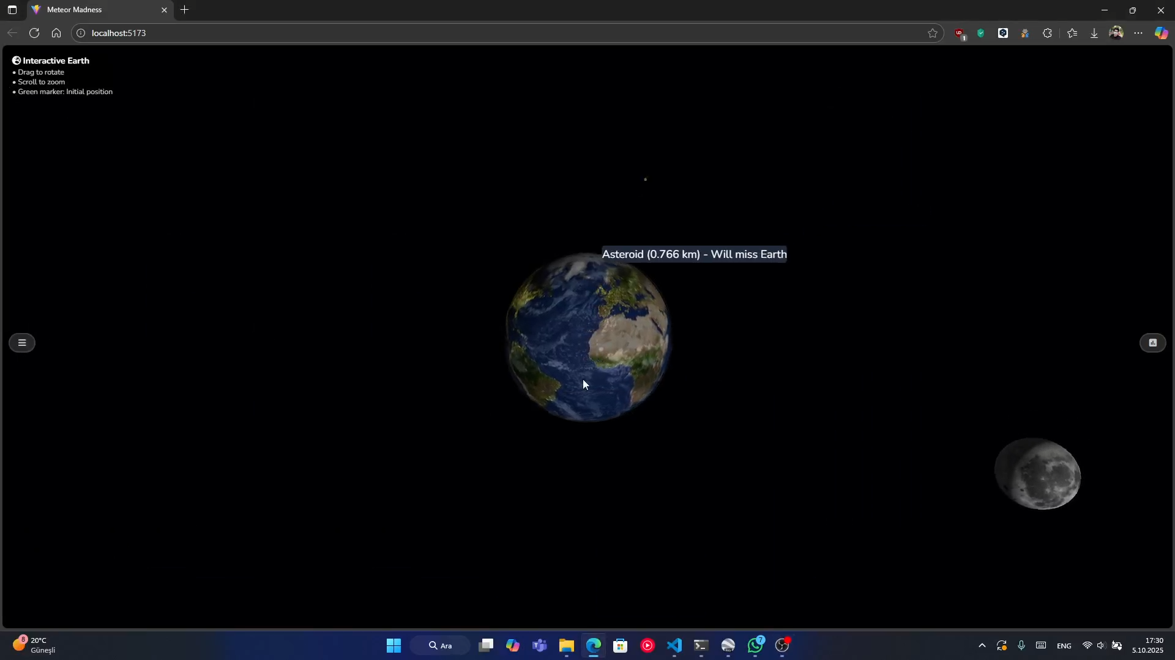
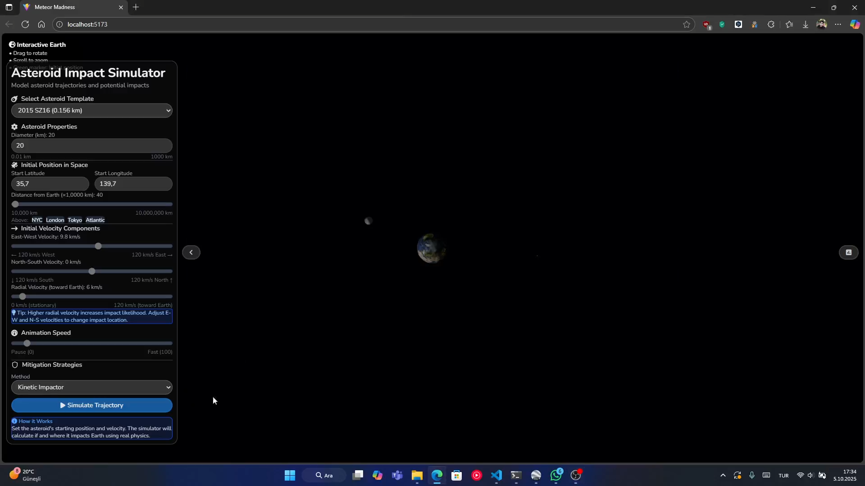
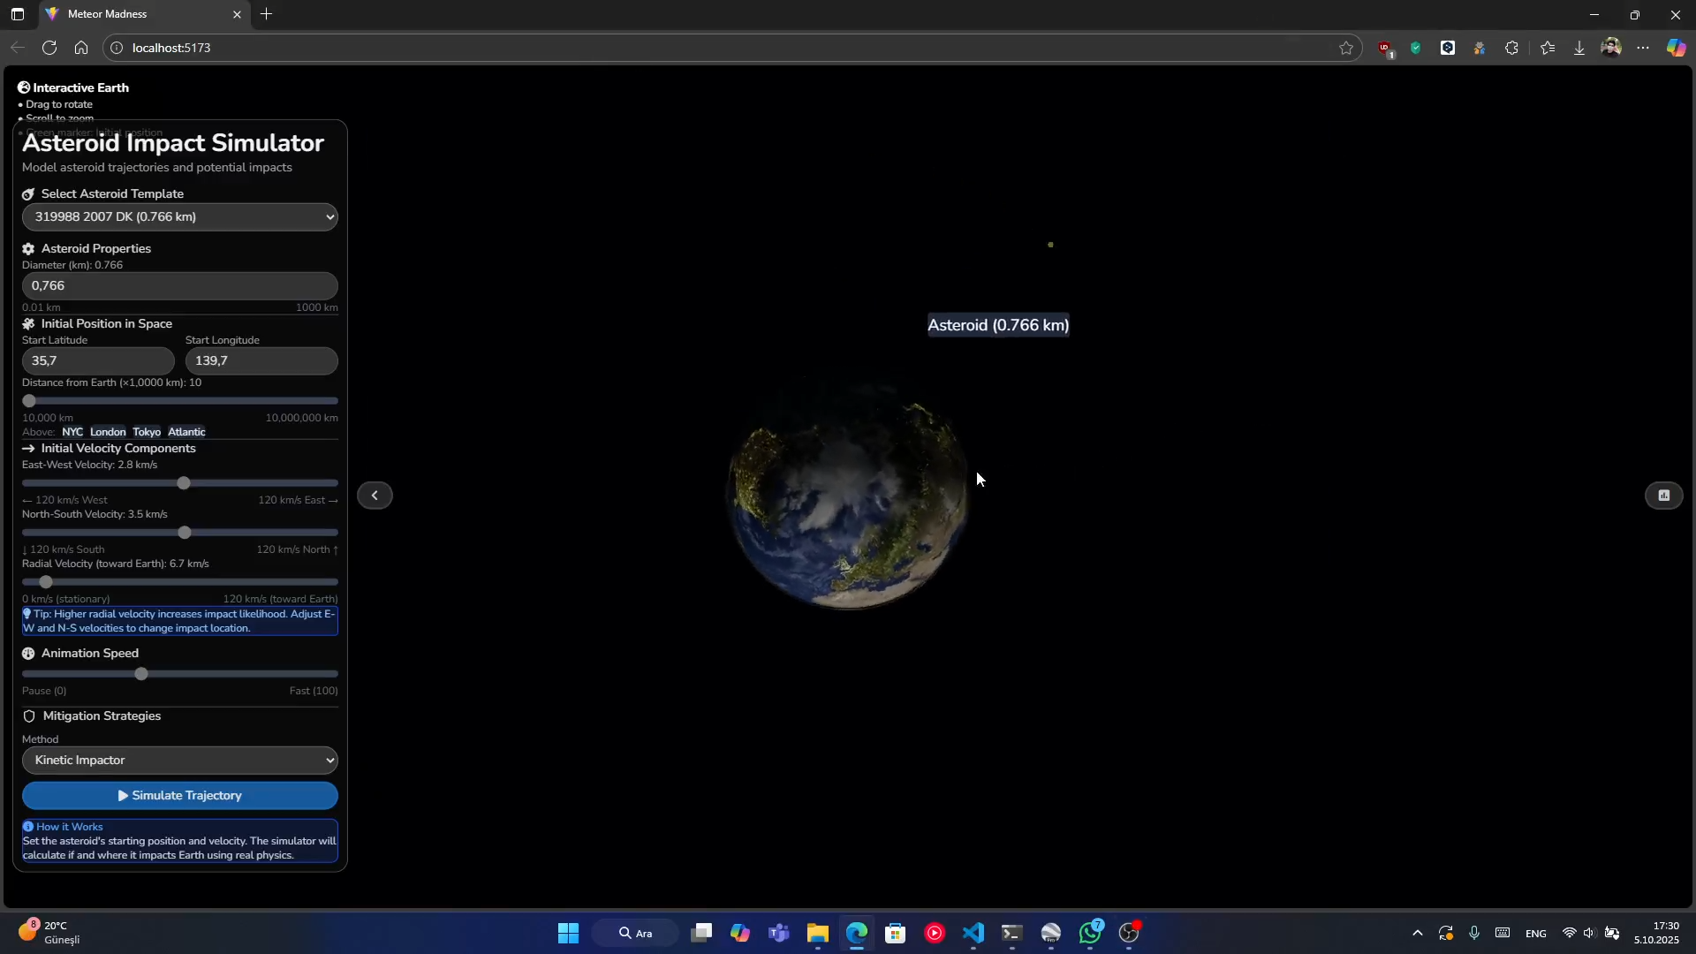
https://github.com/yk38spage/meteorMadness

Slide 7





Preparing Earth for the Unthinkable
Meteor Madness is more than a simulation—it's a critical tool for preparedness and strategic defense planning.
Actionable Intelligence
Transforms NASA API data into direct, understandable action items for emergency management.
Science-Strategy Bridge
Bridges complex astrophysics with real-world decision-making for policymakers.
Empowering Defenders
Empowers the next generation of planetary defenders with visual, interactive tools.
“It’s not just about watching the skies — it’s about being ready when they answer.”
Because the future of planetary defense starts with understanding.
Thank You / Q&A
Thank you. Questions?
Resources & Credits
Project by YMB Developing — Space Apps Challenge 2025

